Slide 1
ML Project Review - 1
Team QuickBytes
Akshay
Vikrant
ANSHUMAN

Slide 2
Pipeline we are following is as follows:
EDA Analysis - Univariate and bivariate analysis between feature columns
Outlier, missing values handling
Encoding, Normalization / Standardization
Implementing Word embedding
Feature Engineering
Training & Testing

Slide 3
Missing value handling
42.69 % (442947) null values present in “brand_name” column
0.5 % (4382) null values present in “category_name” column
2 rows have null value in item_description
Rest all columns are free of missing values
About 604 rows contain price = 0, which are no use for the learning algorithm. Hence we are removing those records.
We will consider missing value in “brand_name” as another separate category called “Unknown”.
Similarly for rows with no item description, we would fill them as “no description available”

Slide 4
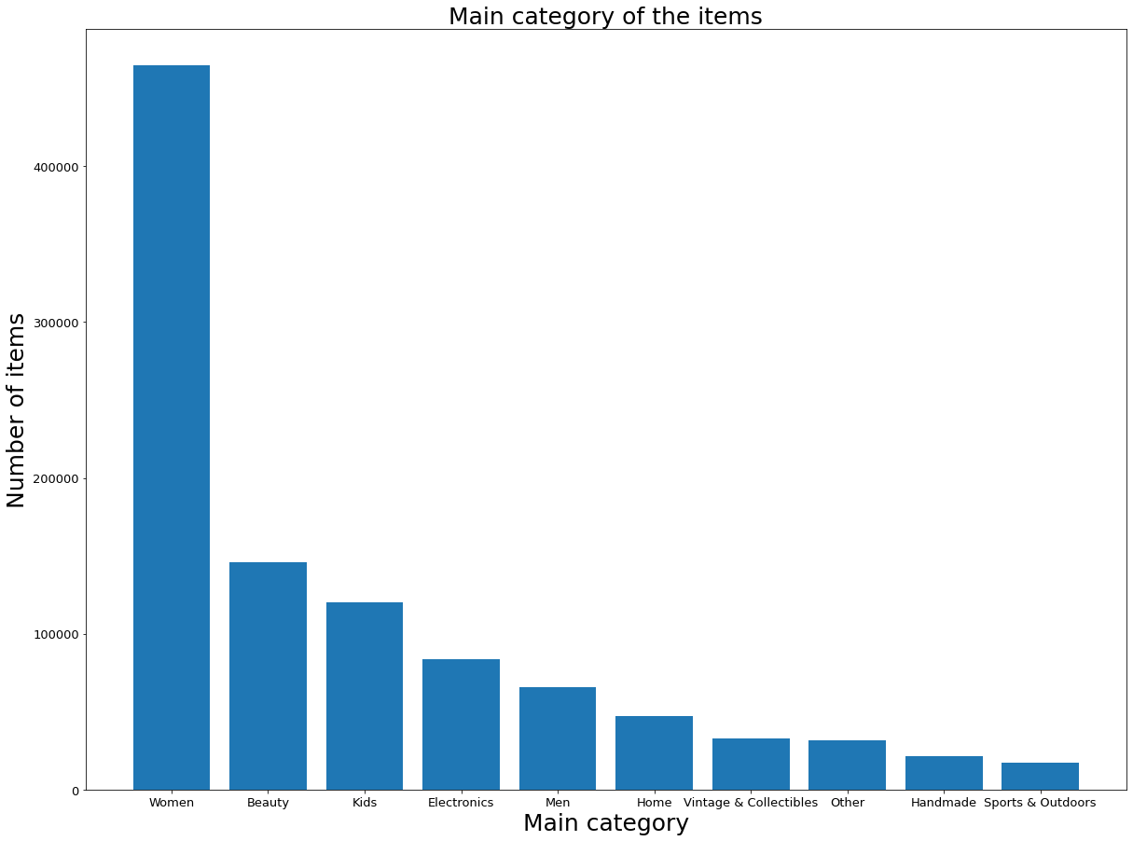
Univariate analysis of category_name
1258 unqiue values in category_name feature
For better generalisation, we are splitting category_name into 3 sub category columns:
Main category
Sub category 1
Sub category 2
Main categories v/s #items

Slide 5
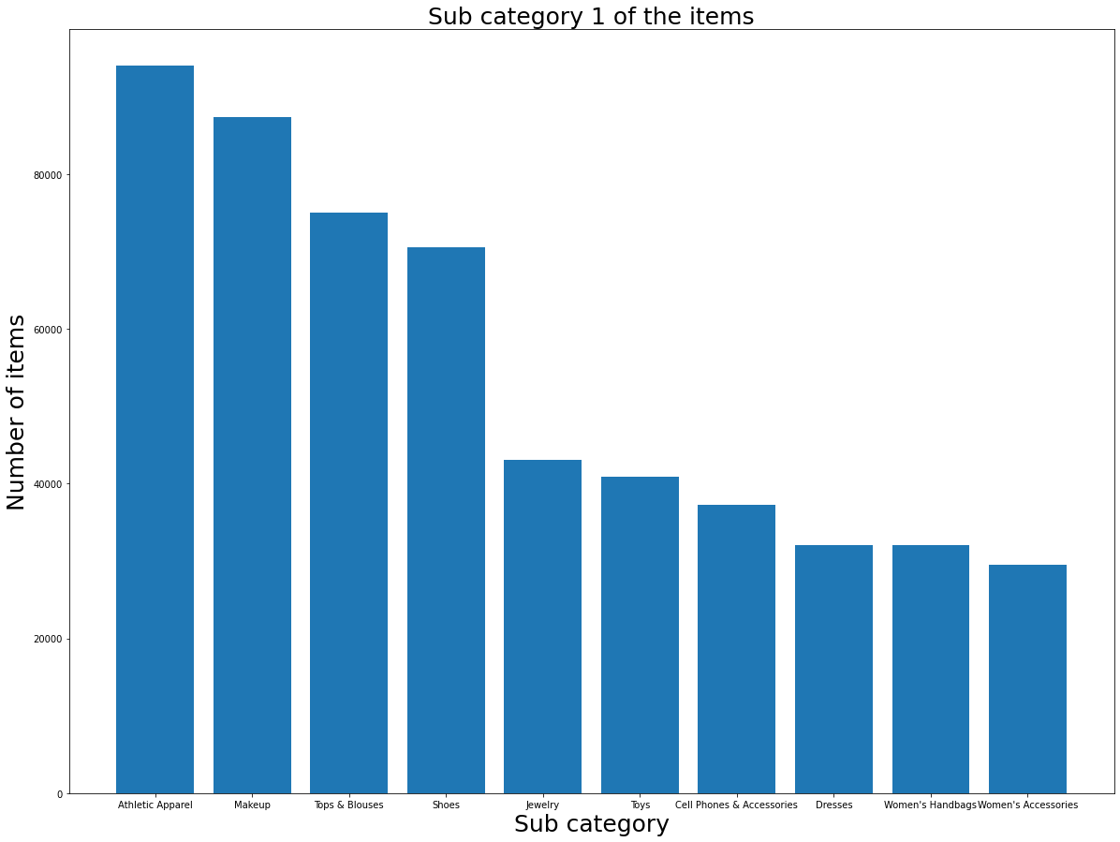
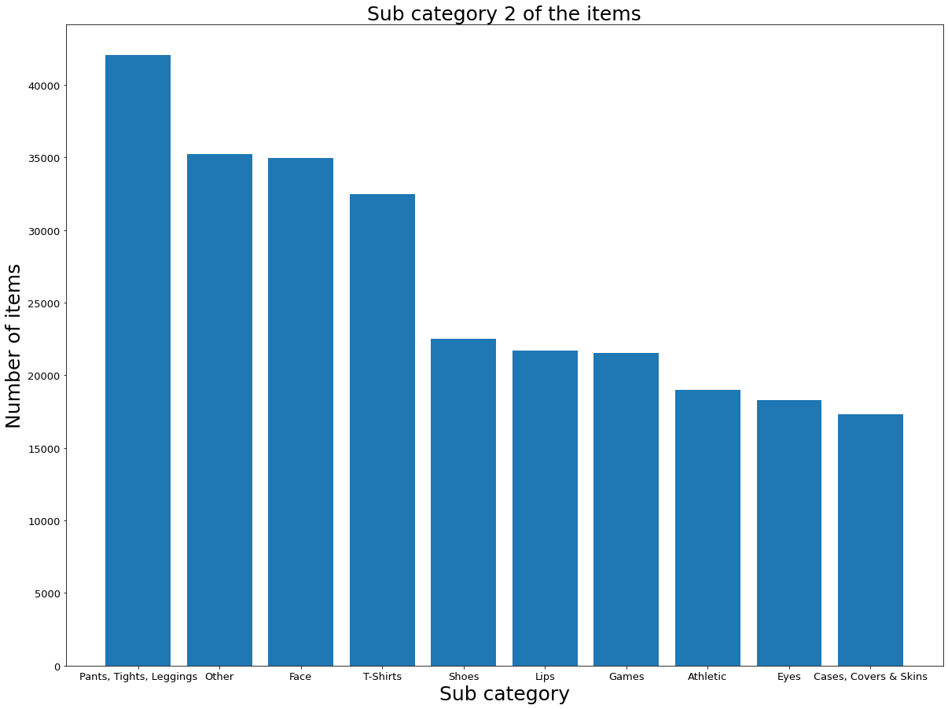

Slide 6
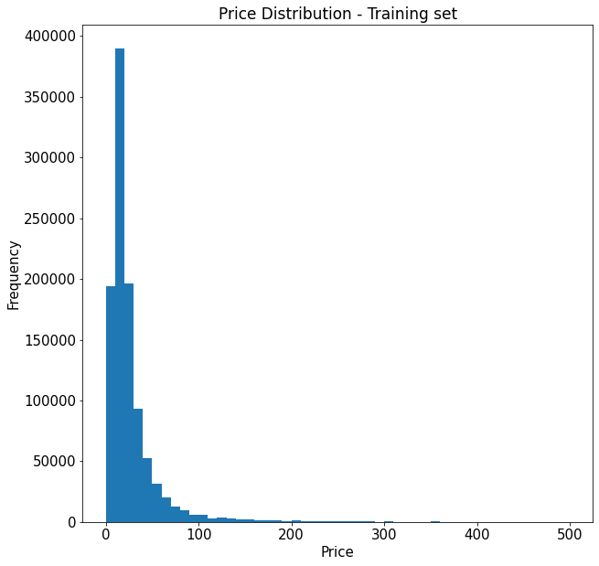
Price Distribution
Findings:
Median price = $17
75% of items have price below $29
Max price in dataset = $2004

Slide 7
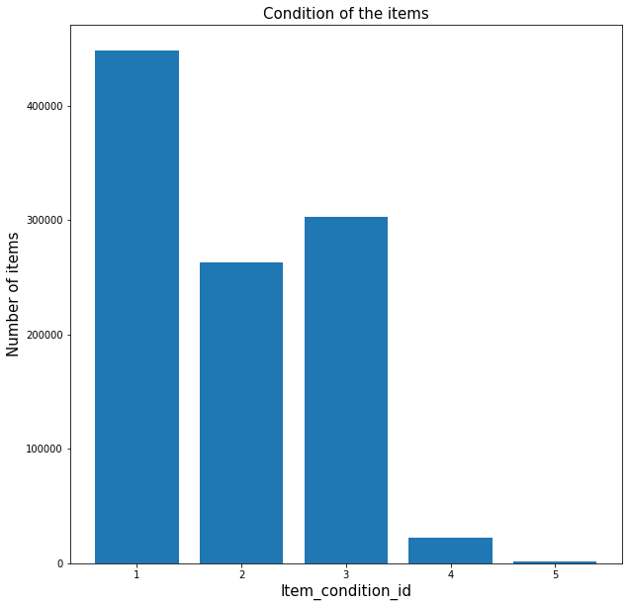
Item condition distribution

Slide 8
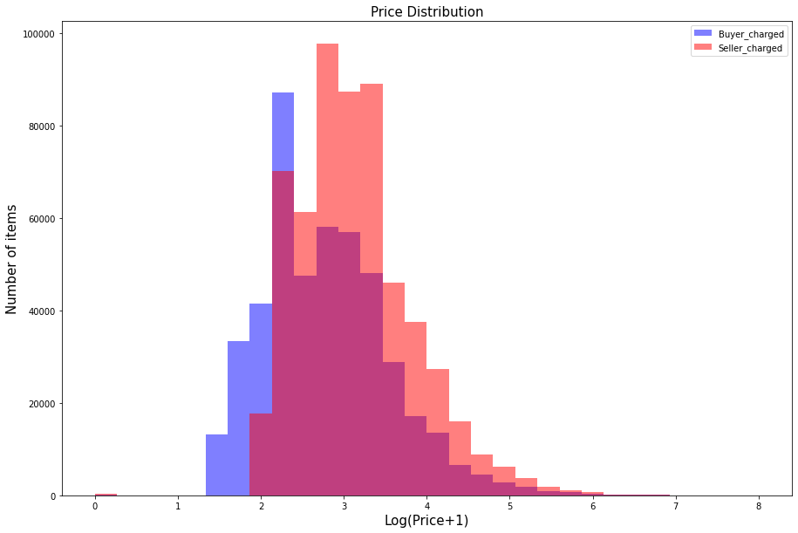
Bi-variate analysis of price v/s shipping
Shipping fee for 55% of items is paid by buyers
Agrees with intuition that for costlier items, seller would pay the shipping price
Shipping fee for 55% of items is paid by buyers

Slide 9
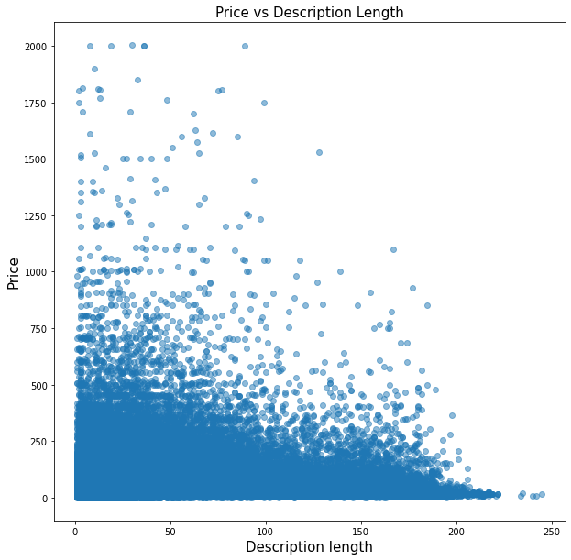
Price vs Description length
Findings:
Items sell better when more description is provided

Slide 10
Data Cleaning
Removing special chars(‘, $, @, : etc)
Removing records with item_description length less than 2 words.
Removing duplicates
TEXT Pre-processing:
Removing stopwords
Converting to lowercase letters
Lemmatization (converting words to it root forms. Eg: don’t -> do not )

Slide 11
Encoding of categorical data
Ordinal Encoding: Best for feature which as ordering.
Label Encoding: For binary features / columns which have less unqiue values (disadvantage: induces unwanted ordering among the data)
One – hot encoding: Doesn’t induce ordering, but increases dimensionality by adding additional columns

Slide 12
Possible Word Embeddings to use:
LSA(Latent Semantic Analysis): effective when working in low-dimensional space & for incoming documents from the same domain zone as the existing ones.
Count Vectorization: Counts occurrence of each word in each document. collects a set of documents and count the occurrence of every word in them.
TF-IDF transforming: The idea is to give term weighting by exploitation of useful statistical measure called tf-idf.
Word2Vec parameter learning, Glove.
FastText: Takes into account morphology of words

